Slide 1
Object-Relational Mapping,
Java Persistence API, and
Hibernate

Slide 2
Learning Objectives:
In this lesson, we will get to know the Java persistence standard based on Hibernate.
By the end of this session, learners will be able to:
Explain Object-Relational Mapping (ORM).
Explain the Hibernate Application Architecture and Hibernate - Annotations.
Describe how to use JPA to store and manage Java objects in a relational database.
Demonstrate the JPA with Hibernate as Implementation.
Demonstrate setting up a Hibernate project.
Identify the Hibernate Query Object (HQO) and Hibernate Query Language (HQL).
Demonstrate how to use Hibernate Query Object (HQO).

Slide 3
Table of Contents
Object Relational Mapping (ORM)
Java Persistence API (JPA)
Overview of Java Hibernate
Hibernate with JPA.
Hibernate Application Architecture.
Persistent objects.
Configuration.
Hibernate Configuration Files
Specify Exact Database Dialect
Hibernate Configuration Property
Session Factory in Hibernate
Session in Hibernate
Important “Session Methods”
Query Object
Setting up a Hibernate.
Entity/POJO/Model Classes
Hibernate Application workflow.
Hibernate - Annotations.
Hibernate Query Object / Hibernate Query Language
HQL - Interfaces
Execution HQL Queries
HQL Methods
Problem with HQL and SQL
Overview of Hibernate Named Query
Advantages of Named Queries
JDBC vs. Java Hibernate

Slide 4
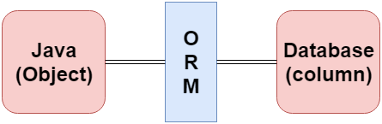
Object Relational Mapping
Object Relational Mapping (ORM) is the concept/process of converting data from object-oriented language to a relational database, and vice versa.
ORM translates the programming code attributes (variables) into the columns in the table. It is good for managing various database operations, such as insertion, update, and deletion effectively.
The mapping between the object model and the relational database should be as follows:
Class <-> Table.
Java Object <-> Row.
Class Attribute <-> Column.
image source: https://learnjava.co.in

Slide 5
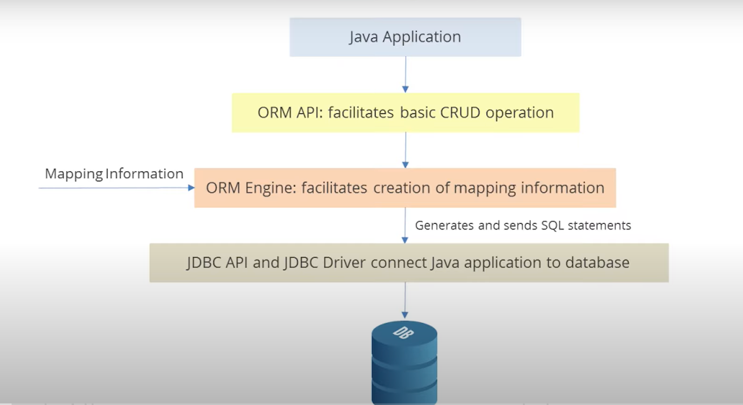
Object Relational Mapping (continued)
ORM Architecture
image source: https://learnjava.co.in

Slide 6
Object Relational Mapping (continued)
Java Persistence API
Java Persistence API (JPA) is the Object-Relational Mapping (ORM) standard for storing, accessing, and managing Java objects in a relational database.
JPA is only a specification; it is not an implementation, but several implementations are available. Popular implementations include Hibernate, EclipseLink, Apache OpenJPA, and many more.
JPA permits the developer to work directly with objects rather than with SQL statements. The JPA implementation is typically called a persistence provider.
JPA is the EE standard specification for ORM in Java EE.
JPA API is a set of rules and a framework to set interfaces for implementing ORM.

Slide 7
Object Relational Mapping (continued)
ORM Problem:
Database interaction requires a great deal of code, and is therefore a burden on data maintenance. Database interaction also requires a proprietary framework.
Solution:
Most contemporary applications use relational database to store data. Recently, many vendors switched to a relational database to reduce the burden on data maintenance. This means that object databases or object relational technologies take care of storing, retrieving, and updating data, as well as maintaining data. The core part of the object relational technologies is the mapping file. As a mapping file does not require compilation, we can easily make changes to multiple data sources with less administration.
ORM is a programming ability or approach to mapping Java objects to database tables, and vice versa. JPA is one possible approach to ORM. By using JPA, the developer can map, store, update, delete, and retrieve data from relational databases to Java objects, and vice versa.

Slide 8
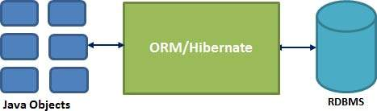
Overview of Java Hibernate
Hibernate is an implementation of JPA API, and uses ORM techniques; in that, we can use the standard JPA API, and configure applications to use Hibernate as the provider of the specification under the covers. Hibernate provides more features beyond what JPA specifies:
The Hibernate framework consists of several components such as Hibernate ORM, Hibernate Search, Hibernate Validator, Hibernate CGM, and Hibernate Tools. In this course, we will use Hibernate ORM, which is the core component of the Hibernate framework for mapping Java model classes.
JDBC is not object-oriented; rather, we are dealing with values means of primitive data. In Hibernate, each record is represented as a Object, but in JDBC, each record is no more than data, which is nothing but primitive values.
Hibernate maps Java classes to database tables, and from Java data types to SQL data types. Hibernate maps also relieve the developer from the majority of common data persistence-related programming tasks. This is especially beneficial for developers with limited knowledge of SQL.
image source: https://learnjava.co.in

Slide 9
Why Hibernate?
At runtime, the Hibernate framework will generate all of the SQL required to interact with the backend database, including:
Reducing lines of code by maintaining object-table mapping itself and returning the result to the application in the form of Java objects, hence reducing the development time and maintenance cost code.
Making an application portable to all RDBMS (SQL) databases.
Handling all create-read-update-delete (CRUD) operations using simple API, no SQL. Hibernate takes care of this mapping / relationships using XML files so that the developer does not need to write code.
Interacting between the database and the Java program through a heavily-tested and robust framework.

Slide 10
Hibernate With JPA
JPA is a specification for persistence providers to implement. Hibernate is one such implementation of JPA specification. We can annotate our classes as much as we like with JPA annotations; however, without an implementation, nothing will happen.
Think of JPA as the guidelines/specification that must be followed, or as an interface while Hibernate’s JPA implementation is code that meets the API, as defined by JPA, providing the “under-the-hood” functionality.
When we use hibernate with JPA, we are actually using the Hibernate JPA implementation. The benefit of this is that we can swap out Hibernate’s implementation of JPA for another implementation of the JPA specification.
When we use straight Hibernate, we lock into the implementation because other ORMs may use different methods/configurations and annotations; therefore, we cannot just switch over to another ORM.
ORM is a set of design patterns for mapping Java objects to database tables, JPA is a specification for interacting with the database, and Hibernate is an implementation of the JPA specification.

Slide 11
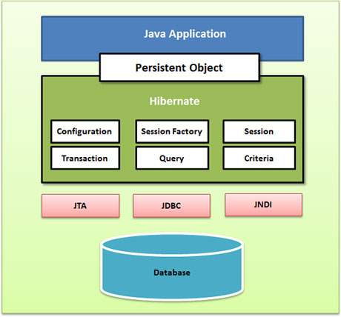
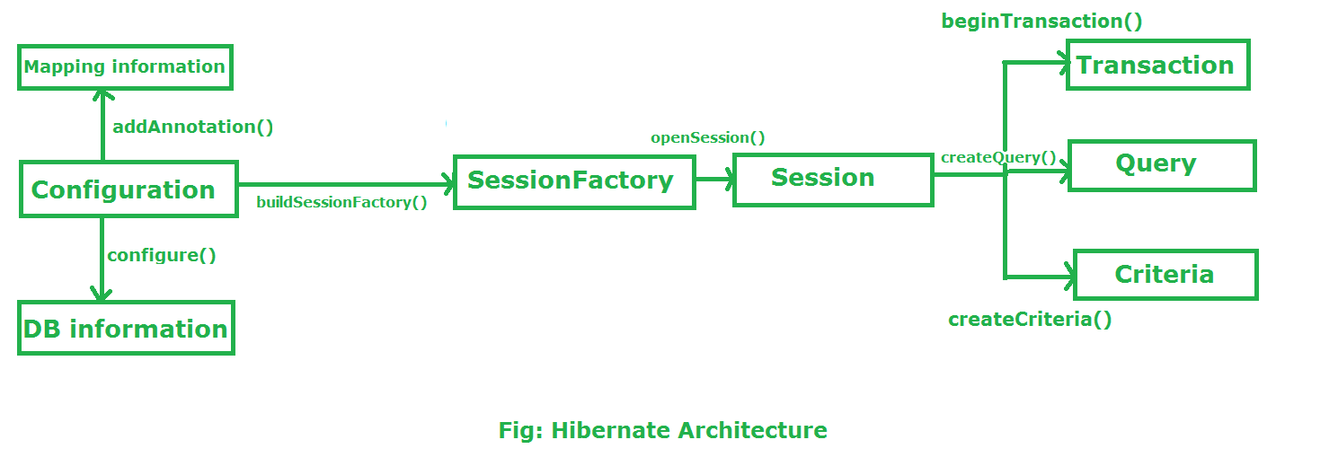
Hibernate Application Architecture
Hibernate has a layered architecture, which helps the user to operate without having to know the underlying APIs. Hibernate makes use of the database and configuration data to provide persistence services (persistent objects) to the application.
Let’s understand what each block represents in detail:
Persistent Objects: Plain Old Java Objects (POJOs), which get persisted as one of the rows in the related table in the database by Hibernate. They can be configured in configuration files (hibernate.cfg.xml or hibernate.properties) or annotated with @Entity annotations.
image source: https://learnjava.co.in
Visit Wiki document for Hibernate Cache

Slide 12
Persistent Objects
Persistent Objects:
Java classes whose objects or instances will be stored in database tables are called persistent classes in Hibernate.
It represents a row in a database table.
Hibernate works best if these classes follow some simple rules, also known as the POJO Programming Model.
These are some rules of persistent classes; however, none are hard requirements:
All Java classes that will be persisted need a default constructor.
All classes should contain an ID in order to allow easy identification of objects within Hibernate and the database. This property maps to the primary key column of a database table.
All attributes that will be persisted should be declared private and have getXXX and setXXX methods defined in the JavaBean style.
A central feature of Hibernate, called proxies, depends upon the persistent class being either non-final, or the implementation of an interface that declares all public methods.
Notes:
An Object that is associated with a session is called a Persistent Object. It represents a row in a database table.

Slide 13
Configuration
Configuration: A class, which is present in the org.hibernate.cfg package. The configuration object is the first Hibernate object; it activates the Hibernate framework and reads both configuration files and mapping files. It is usually created only once during application initialization, and represents a configuration file (hibernate.cfg.xml) or properties file(hibernate.properties).
The configuration object provides two keys components:
Database Connection − Handled through one or more configuration files supported by Hibernate; these files are hibernate.properties or hibernate.cfg.xml.
Class Mapping Setup − Creates the connection between the Java classes and database tables.
Configuration cfg = new Configuration(); //This line activate Hibernate Framework cfg.configure(); // read both cfg file and mapping files
The configuration object is used to create a SessionFactory object in Hibernate.
SessionFactory factory=cfg.buildSessionFactory();

Slide 14
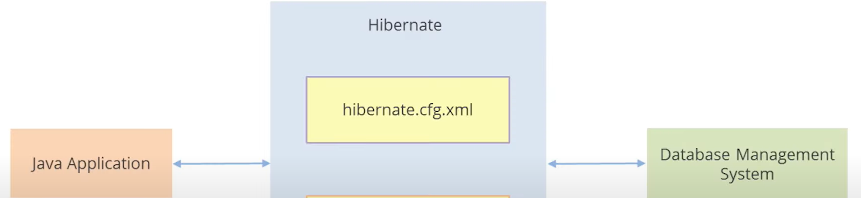
Hibernate Configuration Files
Database details and mapping file details are specified in hibernate.cfg.xml file. The Hibernate engine uses these files to generate Database specific SQL syntax.
image source: https://learnjava.co.in

Slide 15
Hibernate Configuration Files (continued)
Example - hibernate.cfg.xml
<?xml version="1.0" encoding="UTF-8"?><!DOCTYPE hibernate-configuration PUBLIC "-//Hibernate/Hibernate Configuration DTD 5.3//EN" http://www.hibernate.org/dtd/hibernate-configuration-5.3.dtd">
<hibernate-configuration> <session-factory>
<property name="hibernate.hbm2ddl.auto"> update </property>
<property name="connection.driver_class">com.mysql.cj.jdbc.Driver</property>
<property name="connection.url">jdbc:mysql://localhost:3306/databasename</property>
<property name="connection.username">root</property>
<property name="connection.password">password</property>
<property name="dialect">org.hibernate.dialect.MySQL5Dialect</property>
<property name="hibernate.show_sql" >true </property>
<property name="hibernate.format_sql" >true </property>
<mapping class="com.test.hib.model.User"/>
<mapping class="com.perscholas.model.Employee"/>
</session-factory>
</hibernate-configuration>
Notes:
For Eclipse IDE: To create the configuration file, To do so, right click on src/main/java → New → Other - search files from search panel → click on File → specify the file name “hibernate.cfg.xml” → Finish. Write the above code in it.
For intellij IDE: Create a configuration file named hibernate.cfg.xml under the resources folder, and write the above code in it.

Slide 16
Specify Exact Database Dialect
Hibernate uses the SQL syntax of the target database to create tables accordingly; therefore, it is important to specify database dialect information exactly to match the type of underlying database. Otherwise, you will get an error or an undesired behavior.
Example for MySQL database:
<property name="dialect">org.hibernate.dialect.MySQL5Dialect</property>

Slide 17
Hibernate Configuration Property
To use Hibernate Forward Engineering, you need to specify the hibernate.hbm2ddl.auto property in the Hibernate configuration file. The “hibernate.hbm2ddl.auto” property accepts the following values:
create: If the value is created, Hibernate creates a new table in the database when the SessionFactory object is created. If a table exists in the database with the same name, it deletes the table along with the data and creates a new table.
update: If the value is updated, Hibernate first validates whether the table is present in the database or not. If it is present, Hibernate alters that table per the changes; if it is not present, Hibernate creates a new one.
validate: If the value is validated, Hibernate only verifies whether the table is present. If the table does not exist, Hibernate throws an exception.
create-drop: If the value is create-drop, Hibernate creates a new table when SessionFactory is created, performs the operation, and deletes the table when SessionFactory is destroyed. This value is used for testing the Hibernate code.
none: It does not make any changes to the schema.
Example: <property name=”hibernate.hbm2ddl.auto”>create</property>

Slide 18
Session Factory in Hibernate
SessionFactory() Object:
SessionFactory is an interface, which is present in the org.hibernate package.
Configuration object is used to create a SessionFactory object. The SessionFactory is a thread-safe object and is used by all of the threads of an application.
It is usually created during application start-up and kept for later use. We would need one SessionFactory object per database, using a separate configuration file. So, if you are using multiple databases, you would have to create multiple SessionFactory objects.
The SessionFactory in Hibernate is responsible for the creation of Session objects.
SessionFactory factory=cfg.buildSessionFactory(); // buildSessionFactory() method gathers the meta-data which is in the cfg Object. From cfg object it takes the JDBC information and create a JDBC Connection.

Slide 19
Session in Hibernate
Session() Object:
Session is an interface, which is present in the org.hibernate package. A Session is used to get a physical connection with a database. A Session object is created based upon a SessionFactory() object.
A Session() is designed to be instantiated each time an interaction is needed with the database.
The Session objects should not be kept open for a long time because they are not usually thread-safe, and they should be created and destroyed as needed.
A Session object is used to perform Create, Read, Update, and Delete(CRUD) operations for instances of mapped entity classes. Instances may exist in one of three states:
Transient: never persistent; not associated with any Session.
Persistent: associated with a unique Session.
Detached: previously persistent; not associated with any Session.
Session session = factory.buildSession();

Slide 20
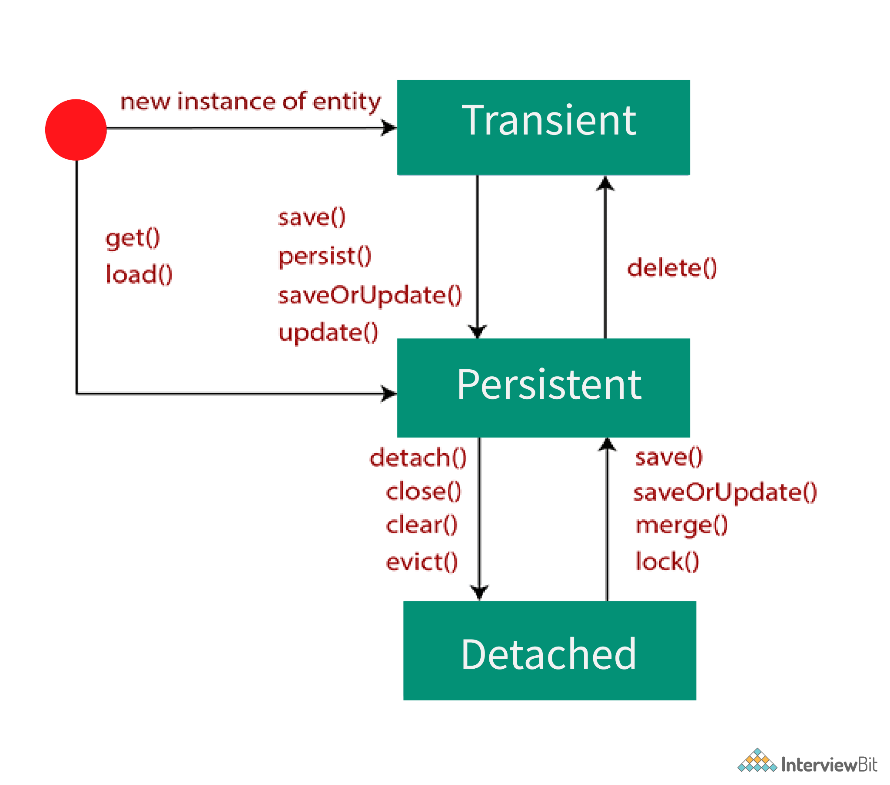
Session in Hibernate (continued)
Here is a simplified state diagram with comments on Session methods that make the state transitions happen:
Session States Life Cycle
image source: www.baeldung.com/

Slide 21
Important “Session Methods”
The Session Interface has several methods that save the objects to the database:
persist() or save()
merge() or update()
Remove() or Delete()
SaveOrUpdate()

Slide 22
session.persist() method
The session.persist() method is used to add a new entity instance to the persistence context, (i.e. transitioning an instance from a transient to a persistent state when the transaction is committed).
TestEntity testEntity = new TestEntity("Hello");
session.persist(testEntity);
This statement makes the testEntity object a Persistent one.
User hellouser = new User();
hellouser.setName("ABC");
session.persist(hellouser);
This statement persists the hellouser object to the database.
persist() method INSERT records into database but return type of persist is void.
persist() method guarantees that it will not execute an INSERT statement if it is called outside of transaction boundaries.

Slide 23
session.save() method
The session.save() method saves the transient entity and INSERT record into a database when the transaction is committed. This method is used to bring only a transient object to a persistent state. There are two overloading functions of this method:
save(Object object): Generates a new identifier and INSERT record into a database. The insertion fails if the primary key already exists in the table.
save(String entityName, Object object): Accepts the entity name and instance of entity.
The purpose of the save() method is the same as the persist() method, but it has different implementation details. The save method always persists the instance to the database by generating a unique identifier.
Note: Save() method is deprecated. Save() is no longer used; instead, we should use the persist() method. However, The save() method could be important for an interview because legacy applications still use it.

Slide 24
Session.merge() method
The main intention of the merge() method is to update a persistent entity instance with new field values from a detached entity instance.
The merge() method is used to merge an object with a persistent object on the basis of the same identifier.
merge(Object object): Accepts the entity object and returns persistent object.
merge(String entityName, Object object): Passes entity name and entity object.
User user = new User();
user.setName("ABC");
session.merge(user);
session.evict(user);
user.setName("XXX");
User mergedUser = (User) session.merge(user);
In the above example, we persisted the user object, and then detached it. Then we updated its name and merging to the session. The mergedUser object is the persisted entity that represents a row in the database and we have to discard the detached user object

Slide 25
Session.SaveOrUpdate()
The SaveorUpdate() method is similar to the Update method in reattaching the instances. The major difference is this method does not throw exceptions upon saving a transient instance instead it transitions the transient object to the persistent state.
User user = new User();
user.setName("ABC");
session.saveOrUpdate(user);
The above code makes the transient user object a persistent one. This is a safer method to use when compared to the update method as it can work on both transient and detached objects.

Slide 26
Session.delete() method or Session.remove() method
In Hibernate, an entity can be removed from a database by calling the Session.delete() or Session.remove(). Using these methods, we can remove a transient or persistent object from datastore.
Note: The delete() method is deprecated, and is no longer used. Instead, we should use the remove() method.

Slide 27
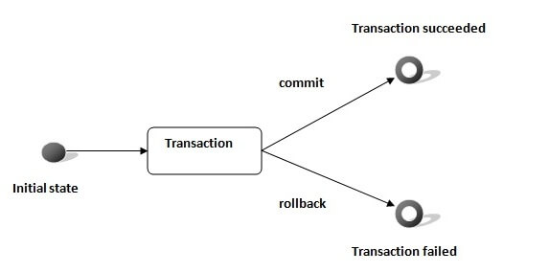
Transaction
Transaction: Enables you to achieve data consistency and rollback in case something unexpected happens. A transaction can be described by Atomicity, Consistency, Isolation, and Durability (ACID) properties. It maintains abstraction from the transaction implementation (JTA,JDBC).
Transaction tx=session.beginTransaction(); tx.commit();
The methods of Transaction interface are as follows:
void begin() starts a new transaction.
void commit() ends the unit of work unless we are in FlushMode.NEVER.
void rollback() forces this transaction to rollback.
void setTimeout(int seconds) sets a transaction timeout for any transaction started by a subsequent call to begin on this instance.
boolean isAlive() checks if the transaction is still alive.
void registerSynchronization(Synchronization s) registers a user synchronization callback for this transaction.
boolean wasCommited() checks if the transaction is committed successfully.
boolean wasRolledBack() checks if the transaction is rolled back successfully.

Slide 28
Query Object
Query Interface:
Query is an interface that presents inside org.hibernate package.
A Query instance is obtained by calling Session.createQuery() method.
Query objects use SQL or Hibernate Query Language (HQL) to retrieve data from the database and create objects. A Query instance is used to bind query parameters, limit the number of results returned by the query, and finally, to execute the query.
Query query=session.createQuery();

Slide 29
Setting up a Hibernate
Create Java Maven Project.
Configure Maven Dependencies for Hibernate and Database in pom.xml file.
<!-- https://mvnrepository.com/artifact/org.hibernate/hibernate-core --> <dependency> <groupId>org.hibernate</groupId> <artifactId>hibernate-core</artifactId> <version>5.5.7.Final</version> </dependency> <dependency> <groupId>org.hibernate</groupId> <artifactId>hibernate-annotations</artifactId> <version>3.5.5-Final</version> </dependency> <!-- https://mvnrepository.com/artifact/mysql/mysql-connector-java --> <dependency> <groupId>mysql</groupId> <artifactId>mysql-connector-java</artifactId> <version>8.0.25</version> </dependency>
Maven automatically downloads the required JAR files.

Slide 30
Entity/POJO/Model Classes
Entity is a Java object that is going to be persisted. Entity classes are decorated with Java annotations such as @Entity, @Id, @Table, or @Column.
Entities are nothing but beans or models, and they contain default constructor, setter, and getter methods for the attributes or private variables (class variables).
Notes:
POJO: Plain old Java object. Click here for more information Wikipedia.

Slide 31
Hibernate Application Workflow
Phase 1 Composed of...
Add Maven dependencies for Hibernate and mysql.
POJO Classes:
▶ Creating Entities - Entities are nothing but beans or Models, and they contain default constructor, setter, and getter methods of those attributes.
(Note: We will be handling this via annotations.)
DAO/Service Classes containing service methods:
▶ Create, Update, Delete, or Find a record.
Phase 2 Composed of…
Mapping File: Hibernate Configuration:
▶ Configurations - Database connection information, schema level settings, and entity mapping, using the mapping file (hibernate.properties or hibernate.cfg.xml).

Slide 32
Hibernate - Annotations
Annotations:
We can write configurations using annotations. The annotations are used for classes, properties, and methods. Annotations start with the ‘@’ symbol, and are declared before the class, property, or method is declared.
Hibernate Annotations is a powerful way to provide the metadata for the Object and Relational Table mapping.
Annotations used in our examples:
Annotation | Description
@Entity | This annotation indicates that the class is mapped to a database table. By default, the ORM framework understands that the class name is the same as the table name. The @Entity annotation must be placed before the class definition.
@Table | This annotation is used if the class name is different than the database table name, and it must be placed before the class definition.
@Id | This annotation specifies that a field is mapped to a primary key column in the table.
@Basic | This annotation tells JPA the below variable is a regular attribute.

Slide 33
Hibernate - Annotations (continued)
Annotation | Description
@Column | This annotation is used to map an instance field of the class to a column in the database table, and it is placed before the getter method of the field. By default, Hibernate can implicitly infer the mapping based on field name and field type of the class, but if the field name and the corresponding column name are different, we have to use this annotation explicitly: @Column(name = "ACC_NO", unique = false, nullable = false, length = 100) private String accountNumber;
@JoinColumn | This annotation is used to map the foreign key column of a managed association (e.g., one-to-one, many-to-one, many-to-many).
@TableGenerator | This annotation is used to specify the value generator for the property specified in @GeneratedValue annotation. It creates a table for value generation.
@ColumnResult | This annotation references the name of a column in the SQL query using the select clause.
@GeneratedValue | If the values of the primary column are auto-increment, we need to use this annotation along with one of the following strategy types: AUTO, IDENTITY, SEQUENCE, and TABLE. In our case, we use the strategy IDENTITY, which specifies that the generated values are unique at table level, whereas the strategy AUTO implies that the generated values are unique at database level.

Slide 34
Hands-On Lab
Complete the following labs, You can find these labs on Canvas under the Assignment section.
For Eclipse users: GLAB - 305.4.1A - Hibernate Project Demonstration
For IntelliJ users: GLAB - 305.4.1B - Hibernate Project Demonstration with IntelliJ Ultimate
Important note:
The instructor should give demonstration of the above labs in the class.
If you have any technical questions while performing the lab activity, ask your instructors for assistance.

Slide 35
Practice Assignment
Using Hibernate, create a Department Model with the following attributes:
int did
String name
String state
Using Hibernate, create the relevant services for this Model (create, update name/state, find, and delete).
Do not forget to add your model to the configuration file (hibernate.cfg.xml).
If you have any technical questions while performing this practice assignment, ask your instructors for assistance.

Slide 36
Knowledge Check
What is the difference between ORM, JPA, and Hibernate?
Why do we need Hibernate instead of JDBC ?

Slide 37
Summary
Object Relational Mapping (ORM) is a concept/process of converting the data from Object Oriented Language to relational database, and vice versa. In Java, this is performed with the help of reflection and JDBC.
Java Persistence API is one step above ORM. It has a high-level API and specification requirement so that different ORM tools can implement it and provide the flexibility to change the implementation from one ORM to another (e.g., if an application uses the JPA API and implementation is hibernate).

Slide 38

Let’s Take A Break…
Notes:
I’ve included several “End” Signs. Mix them up as you build your deck (to keep it from getting boring).

Slide 39
Hibernate Query Object / Hibernate Query Language

Slide 40
Hibernate Query Object / Hibernate Query Language
Hibernate created a new language named Hibernate Query Language (HQL). The syntax is quite similar to database SQL language. The main difference is that HQL uses class name instead of table name, and property names instead of column names.
The Hibernate Query Object - HQL is used to retrieve data from the database.
Keywords, such as SELECT, FROM, and WHERE, etc. are not case-sensitive, but properties such as table and column names are case-sensitive in HQL.
HQL has many benefits, including that it is database independent, polymorphic queries are supported, and it is easy to learn for Java programmers.
Visit Wiki document for more details and information about HQL.
Notes:
https://docs.jboss.org/hibernate/orm/3.2/api/org/hibernate/Query.html

Slide 41
Hibernate Query Object / Hibernate Query Language (continued)
Commonly supported clauses in HQL:
HQL From: HQL From is the same as a select clause in SQL. For example, from Employee is the same as select * from Employee.We can also create aliases, such as from Employee emp or from Employee as emp.
HQL JOIN: HQL supports inner JOIN, left JOIN, right JOIN, and full JOIN (e.g., select e.name, a.city from Employee e INNER JOIN e.address a). In this query, Employee Class should have a variable named address.
Aggregate Functions: HQL supports commonly used aggregate functions such as count(*), count(distinct x), min(), max(), avg(), and sum().
Expressions: HQL supports arithmetic expressions (+, -, *, /), binary comparison operators (=, >=, <=, <>, !=), and logical operations (and, or, not), etc.
HQL supports order by and group by clauses, subqueries such as SQL queries, and DDL and DML.

Slide 42
HQL - Interfaces
Query Interface:
Query is an interface that presents inside org.hibernate package.
A Query instance is obtained by calling Session.createQuery().
Query objects use SQL or Hibernate Query Language (HQL) strings to retrieve data from the database and create objects. A Query instance is used to bind query parameters, limit the number of results returned by the query, and finally, to execute the query.
Hibernate provides different techniques to query database, including, TypedQuery, NamedQuery and Criteria API. TypedQuery and NamedQuery are two additional Query sub-types.
Query query=session.createQuery(); or TypedQuery query = session.createQuery();

Slide 43
HQL - Interface (continued)
Query Interface should be used mainly when the query result type is unknown or when a query returns polymorphic results, and the lowest known common denominator of all the result objects is Object. When a more specific result type is expected, queries should usually use the TypedQuery interface. It is easier to run queries and process the query results in a type safe manner when using the TypedQuery interface.
Example: Building Queries with createQuery
Query q1 = session.createQuery("SELECT c FROM Employee e");
TypedQuery<Employee> q2 =session.createQuery("SELECT c FROM Employee e", Employee .class);
In the above code, the same HQL query retrieves all of the Employee objects in the database is represented by both q1 and q2. When building a TypedQuery instance, the expected result type has to be passed as an additional argument, as demonstrated for q2, because in this case, the result type is known (the query returns only Employee objects), a TypedQuery is preferred.

Slide 44
Execution HQL Queries
The Query interface defines two methods for running SELECT queries:
Query.getSingleResult - use when exactly one result object is expected.
Query.getResultList - use when multiple result objects are expected.
The TypedQuery interface defines the following methods:
TypedQuery.getSingleResult - use when exactly one result object is expected.
TypedQuery.getResultList - use when multiple result objects are expected
In addition, the Query interface defines a method for running DELETE and UPDATE queries:
Query.executeUpdate - for running only DELETE and UPDATE queries.

Slide 45
HQL Methods
Here are a few important Query methods, which will be used often in Hibernate implementations:
getSingleResult: Execute a SELECT query that returns a single result.
list(): Return the query results as a list. If the query contains multiple results per row, the results are returned in an instance of Object[], but use the getResultList() method instead of list() because this is a deprecated (out of date) method.
getResultList(): The default implementation of the getResultList() method is in org.hibernate package. Query calls the list() method. Execute a SELECT query and return the query results as an untyped list.
General rule for the getResultList():
If select contains a single expression and it is an entity, the result is that entity.
If select contains a single expression and it is a primitive, the result is that primitive.
If select contains multiple expressions, the result is List<Object[]>, containing the corresponding primitives/entities.

Slide 46
HQL Methods (continued)
executeUpdate(): This method is used to run the update/delete query. It returns the number of entities updated or deleted.
setParameter(): Bind a value to a JDBC-style query parameter. The Hibernate type of the parameter is first detected via the usage/position in the query, and if not sufficient, secondly guessed from the class of the given object.
setMaxResults(): Set the maximum number of rows to retrieve. If not set, there is no limit to the number of rows retrieved.
Visit the link below for more information.
https://docs.jboss.org/hibernate/jpa/2.1/api/javax/persistence/Query.html#getResultList()
Note: Because Hibernate libraries are often updated, some methods, interfaces, and constructors may be deprecated. View the official document link below to view the deprecated list, and replace the version:
https://docs.jboss.org/hibernate/orm/3.2/api/org/hibernate/engine/NamedSQLQueryDefinition.html#NamedSQLQueryDefinition(java.lang.String,%20java.lang.String,%20java.util.List,%20boolean,%20java.lang.String,%20java.lang.Integer,%20java.lang.Integer,%20org.hibernate.FlushMode,%20java.util.Map,%20boolean)

Slide 47
Clauses in the HQL
FROM Clause:
You will use the FROM clause if you want to load a complete persistent object into memory. Following is the simple syntax of using the FROM clause:
public static void main(String[] args) {
SessionFactory factory = new Configuration().configure().buildSessionFactory();
Session session = factory.openSession();
String hql = "FROM User"; // Example of HQL to get all records of user class
TypedQuery query = session.createQuery(hql);
List<User> results = query.getResultList();
for (User u : results) {
System.out.println("User Id: " +u.getId() + "|" + " Full name:" + u.getFullname() +"|"+ "Email: " + u.getEmail() +"|"+ "password" + u.getPassword());
}
}

Slide 48
Clauses in the HQL (continued)
WHERE Clause: If you want to narrow the specific objects that are returned from storage, use the WHERE clause. Following is the simple syntax of using the WHERE clause:
public static void main(String[] args) {
SessionFactory factory = new Configuration().configure().buildSessionFactory();
Session session = factory.openSession();
String hql = "FROM User u WHERE u.id = 2" ; // Example of HQL to get all records of user class
TypedQuery query = session.createQuery(hql);
List<User> results = query.getResultList();
for (User u : results) {
System.out.println("User Id: " +u.getId() + "|" + " Full name:" + u.getFullname() +"|"+ "Email: " + u.getEmail() +"|"+ "password" + u.getPassword());
}}
HQL supports the list of expressions that are used in the where clause:
math operators: +, -, *, /
comparison operators: =, >=, <=, <>, !=, like
logical operations: and, or, not
is empty, is not empty, in, not in, between, is null, is not null, member of and not member of
string concatenation concat(…,…)
current_date(), current_time(), and current_timestamp()
str() for converting values to a readable string

Slide 49
Clauses in the HQL (continued)
ORDER BY Clause:
To sort your HQL query results, you will need to use the ORDER BY clause. You can order the results by any property on the objects in the result set (ascending [ASC] or descending [DESC]). Following is the simple syntax of using ORDER BY clause:
public static void main(String[] args) {
SessionFactory factory = new Configuration().configure().buildSessionFactory();
Session session = factory.openSession();
String hql = "FROM User E WHERE E.id > 3 ORDER BY E.salary DESC";
TypedQuery query = session.createQuery(hql);
List<User> results = query.getResultList();
for (User u : results) {
System.out.println("User Id: " +u.getId() + "|" + " Full name:" + u.getFullname() +"|"+ "Email: " + u.getEmail() +"|"+ "password" + u.getPassword());
}
}

Slide 50
Multiple SELECT Expressions
The SELECT clause may also define composite results:
SELECT U.salary, U.fullname FROM User AS U;
The result list of above query contains Object[] elements, one per result. The length of each result Object[] element is 2. The first array cell contains the salary (U.salary) and the second array cell contains the Full name (U.fullname). The following code demonstrates the above query
public static void main(String[] args) {
SessionFactory factory = new Configuration().configure().buildSessionFactory();
Session session = factory.openSession(); TypedQuery<Object[]> queryy = session.createQuery( "SELECT U.salary, U.fullname FROM User AS U", Object[].class);
List<Object[]> resultss = queryy.getResultList();
for (Object[] a : resultss) {
System.out.println("Salary: " + a[0] + ", Full name: " + a[1]); }
}}

Slide 51
Clauses in the HQL (continued)
GROUP BY Clause and Aggregate function
This clause lets Hibernate pull information from the database and group it based on a value of an attribute; and typically, uses the result to include an aggregate value. Following is the simple syntax of using GROUP BY clause:
public static void main(String[] args) {
SessionFactory factory = new Configuration().configure().buildSessionFactory();
Session session = factory.openSession();
String hql = "SELECT SUM(U.salary), U.city FROM User U GROUP BY U.city";
//The query returns Object[] arrays of length 2
TypedQuery query = session.createQuery(hql);
List<Object[]> result =query.getResultList();
for (Object[] o : result) {
System.out.println("Total salary " +o[0] +" | city: "+ o[1] );
}
} }

Slide 52
Hibernate Parameterized Query
Using Named Parameters:
Hibernate supports named parameters in its HQL queries. Following is the simple syntax of using named parameters:
String hql = "FROM User u WHERE u.id = :id";
TypedQuery query = session.createQuery(hql);
query.setParameter("id", 4);
List<User> result = query.getResultList();
for (User u : result) {
System.out.println("User Id: " + u.getId() + "|" + " Full name:" + u.getFullname() + "|" + "Email: " + u.getEmail() + "|" + "password" + u.getPassword())
}

Slide 53
Hands-On Lab
Complete the following labs, You can find these labs on Canvas under the Assignment section.
For Eclipse users: GLAB 305.4.2A - Demonstration of Hibernate Query Language - HQL
For IntelliJ users: GLAB - 305.4.2B - Demonstration of Hibernate Query Language HQL with Intellij
If you have any technical questions while performing the lab activity, ask your instructors for assistance.

Slide 54
Problem with HQL and SQL
Problem:
A major disadvantage of having HQL and SQL scattered across data access objects is that it makes the code unreadable. Hence, it might make sense to group all HQL and SQL in one place and use only their reference in the actual data access code.
Solution:
Fortunately, Hibernate allows us to do this with Named queries.

Slide 55
Overview of Hibernate Named Query
Hibernate provides “NamedQuery” that can be defined at a central location and can be used anywhere in the code. The Hibernate named query is a way to use any query by some meaningful name. It is like using alias names, whereas the Hibernate framework provides the concept of named queries so that application programmers need not scatter queries to all the Java code.
We can create a NamedQuery for both HQL and Native SQL. A named query is a statically defined query with a predefined, unchangeable query string. Named queries are compiled when SessionFactory is instantiated (essentially, when your application starts up). They are validated when the session factory is created.
If you want to use named query in Hibernate, you need to have knowledge of @NamedQueries annotations and @NamedQuery annotations:
@NamedQuery annotation is used to define the single-named query.
@NamedQueries annotation is used to define the multiple-named queries.
Note: You cannot have two named queries with the same name in Hibernate. Hibernate shows fail-fast behavior in this regard, and will show an error in the application start-up.
Notes:
A major disadvantage of having HQL and SQL scattered across data access objects is that it makes the code unreadable. Hence, it might make sense to group all HQL and SQL in one place and use only their reference in the actual data access code. Fortunately, Hibernate allows us to do this with named queries.

Slide 56
Example - Hibernate Named Query
NamedQuery can be defined in Hibernate mapping files or by using Hibernate annotations.
Named query definition has two important attributes:
name: The name attribute of a named query by which it will be located using hibernate session.
query: Here, you will give the HQL statement to get executed in the database.
User Entity Class - Hibernate Named Query @NamedQuery Annotation
@NamedQueries({
@NamedQuery( name = "findStockByStockCode", query = "from Stock s where s.stockCode = :stockCode" ) })
@Entity
@Table(name = "stock")
public class Stock implements java.io.Serializable { . . ………..
Call a named query - We can call the named query via getNamedQuery method.
Query query = session.getNamedQuery("findStockByStockCode")
.setString("stockCode", "7277");
Query query = session.getNamedQuery("findStockByStockCodeNativeSQL")
.setString("stockCode", "7277");

Slide 57
Example - Hibernate Named Query (continued)
public void UpdateEmployee()
{ SessionFactory factory = new Configuration().configure().buildSessionFactory();
Session session = factory.openSession();
Transaction t = session.beginTransaction();
TypedQuery query = session.getNamedQuery("updateEmpById");
query.setParameter("name", "Elded Leon");
query.setParameter("id", 7);
int rowsAffected = query.executeUpdate();
if (rowsAffected > 0) {
System.out.println(rowsAffected + "(s) were inserted");
}
t.commit();
System.out.println("successfully saved");
}
//Using @NamedQueries for multiple HQL
@NamedQueries({
@NamedQuery(name="updateEmpById", query = "update Employee set Name = :name where id = :id"),
)}

Slide 58
Advantages of Named Queries
Fail fast: Their syntax is checked when the session factory is created, making the application fail fast in case of an error.
Reusable: They can be accessed and used from several places, which increases reusability.

Slide 59
Hands-On Lab
Complete the following labs, You can find these labs on Canvas under the Assignment section.
For Eclipse users: GLAB 305.4.3A - Demonstration - Named Queries in Hibernate
For IntelliJ users: GLAB - 305.4.3B - Demonstration - Named Queries in Hibernate with IntelliJ Ultimate
If you have any technical questions while performing the lab activity, ask your instructors for assistance.

Slide 60
JDBC vs. Java Hibernate
Hibernate performs an Object-Relational Mapping (ORM) framework, while JDBC is simply a database connectivity API.
With JDBC, you need to write database-speciﬁc SQL statements for your DDL, DML, and queries. JPA allows you to avoid writing database-speciﬁc DDL or DML, and to express queries in terms of the Java entities rather than native SQL tables and columns.
JDBC is database dependent (i.e., one needs to write different codes for different databases). Hibernate is database-independent and the same code can work for many databases with minor changes.
The benefits of using Hibernate over JDBC include:
There is reduced boilerplate code.
There is automatic Object Mapping.
It is easy to migrate to a new database.

Slide 61
Knowledge Check
What are the advantages of Hibernate over JDBC?
What are some of the important interfaces of the Hibernate framework?
What is a Session in Hibernate?
Explain a Hibernate Mapping file.

Slide 62
Summary
Hibernate ORM (Object Relational Mapping) is a mapping tool pattern mainly used for converting data stored in a relational database to an object used in object-oriented programming constructs. This tool also helps greatly in simplifying data retrieval, creation, and manipulation.
Hibernate Query Language (HQL) is used as an extension of SQL. It is simple, efficient, and very flexible for performing complex operations on relational databases without writing complicated queries. HQL is the object-oriented representation of query language, (i.e., instead of using table name, we make use of the class name which makes this language independent of any database). This makes use of the Query interface provided by Hibernate. The Query object is obtained by calling the createQuery() method of the hibernate Session interface.

Slide 63
References
https://www.vogella.com/tutorials/JavaPersistenceAPI/article.html#jpaintro_overview
https://docs.jboss.org/hibernate/core/3.3/reference/en-US/html/objectstate.html
https://www.interviewbit.com/hibernate-interview-questions/
https://www.w3schools.blog/hibernate-association-mappings
https://rti.etf.bg.ac.rs/rti/temp/is1_proba/materijali/vezbe/JPA/JPA%20-%20Queries.pdf
Apache®, Apache Tomcat®, Apache Kafka®, Apache Cassandra™, and Apache Geode™ are trademarks or registered trademarks of the Apache Software Foundation in the United States and/or other countries. Java™, Java™ SE, Java™ EE, and OpenJDK™ are trademarks of Oracle and/or its affiliates. Kubernetes® is a registered trademark of the Linux Foundation in the United States and other countries. Linux® is the registered trademark of Linus Torvalds in the United States and other countries. Windows® and Microsoft® Azure are registered trademarks of Microsoft Corporation. “AWS” and “Amazon Web Services” are trademarks or registered trademarks of Amazon.com Inc. or its affiliates. All other trademarks and copyrights are property of their respective owners and are only mentioned for informative purposes. Other names may be trademarks of their respective owners.

Slide 64

End of Module
‹#›

